Slide 1

Housing Price Predictions
Advanced Linear Regression
Rebecca Greber

Slide 2

Multi-phase project on factors affecting housing prices
Final Goal:
How do solar panels affect the cost of a house in different regions of the U.S.?
Where are domestic solar panels gaining momentum or decreasing, and why?
Initial phase:
Which features in available sales data affect the price of homes in Ames, Iowa?

Slide 3

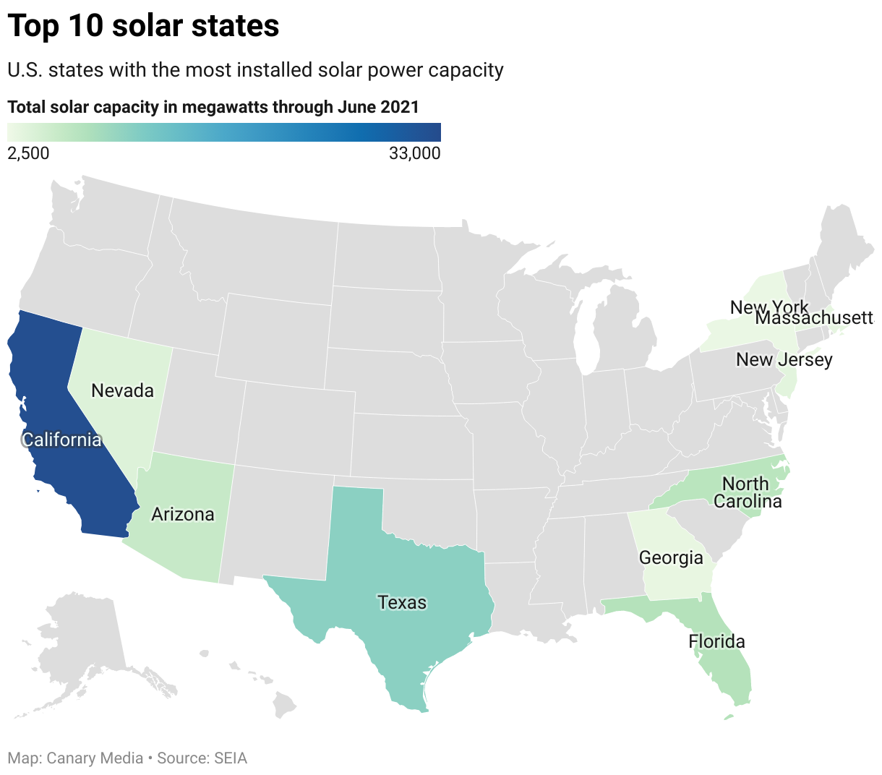
Solar housing is a booming industry
1
Solar panels increase sales prices by 4.1% on average in the U.S.
Top Ten Solar Premiums
New Jersey: 9.9%
Pennsylvania: 4.9%
North Carolina: 4.8%
Louisiana: 4.9%
Washington: 4.1%.
Florida: 4%
Hawaii: 4%
Maryland: 3.8%
New York: 3.6%
South Carolina: 3.5%
In some cities, prices can increase more than 10% California has 10.5 million homes powered only by solar.
2
California Solar Mandate since 2020 requires all new house have solar panels
Massachusetts Green Building law requires all new buildings have no net impact on air quality in the state
3
4
Federal, state, and local tax incentives.
Lending, servicing, and repairing of solar panels are new industries that bring needed jobs to local economies
5

Slide 4
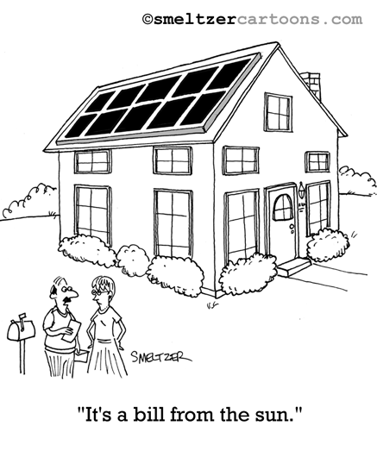
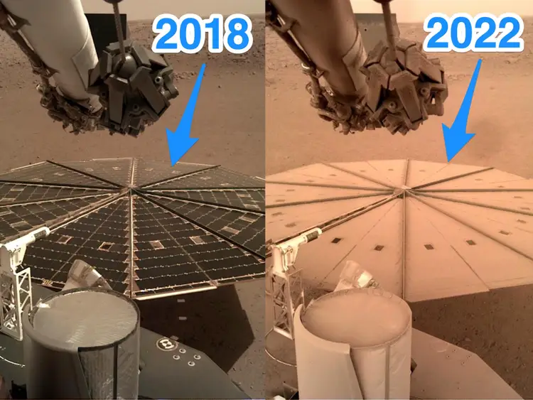



Solar panels are not a panacea
Cleaning
Repairs
Expected degradation over time
Replacement
Disposal and environmental contamination
Smeltzer image used with permission

Slide 5
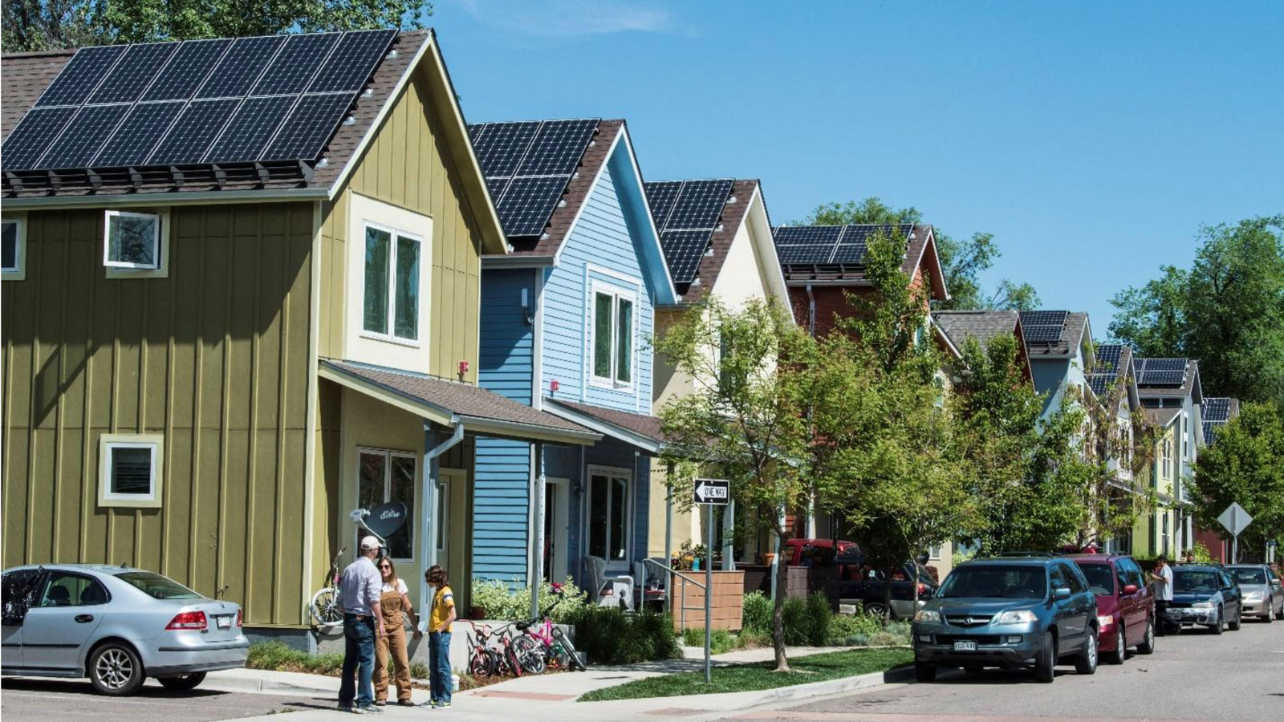



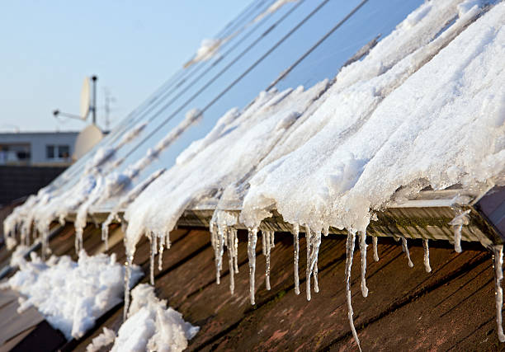


Predicting solar installation on a single house is complex
Geographic Factors
Lot-specific Factors
Demographic Factors
What neighbors are doing
There goes the neighborhood

Slide 6



Data on solar home installations and market price
Lawrence Berkely National Laboratory (2015)
132,000 houses
Stanford University (2018, updated 2022)
1.2 million houses in 600 markets
Zillow’s Housing Market Metrics API
U.S. Energy Information Administration
National Renewable Energy Laboratory’s PV Rooftop Database
(all buildings in 128 metro regions that LIDAR data shows would support a solar installation)

Slide 7
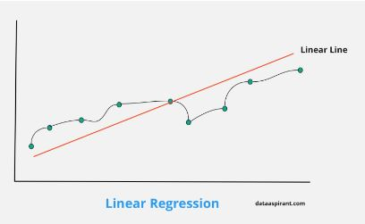
Ames Housing Dataset
Detailed data on house prices in Ames, Iowa
Compiled for academic and educational use
3919 records with 81 attributes each
Provided split into training and testing data of almost equal size
Kaggle “Getting Started” competition on advanced linear regression

Slide 8
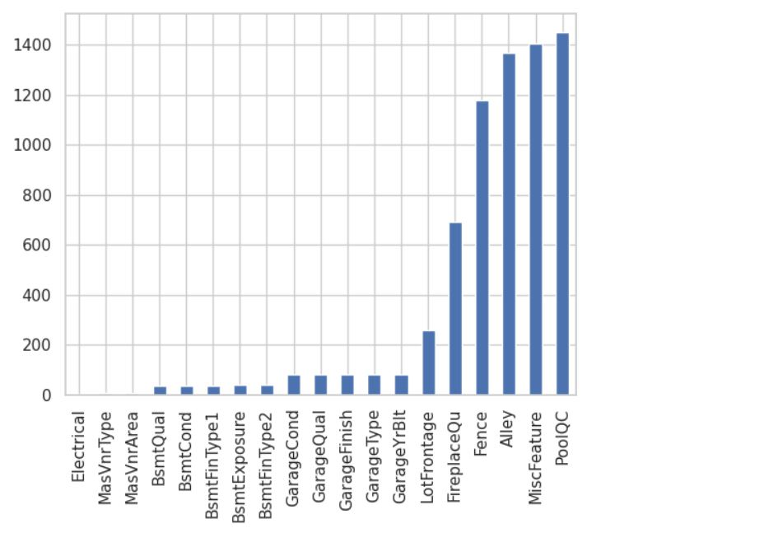
Exploratory Data Analysis
Training and testing data do not have same number of columns
Both training and testing data include categories in many columns that are not in the other data set
Approximately equal number of quantitative and qualitative items
Many missing items in both quantitative and qualitative data
Duplicative or closely-correlated fields
Missing Quantitative Items

Slide 9





Closely Correlated Data
Pool Area and Pool Quality
Overall Condition and Overall Quality
Garage Square Footage and Number of Cars Held
Overall Quality and Overall Condition

Slide 10
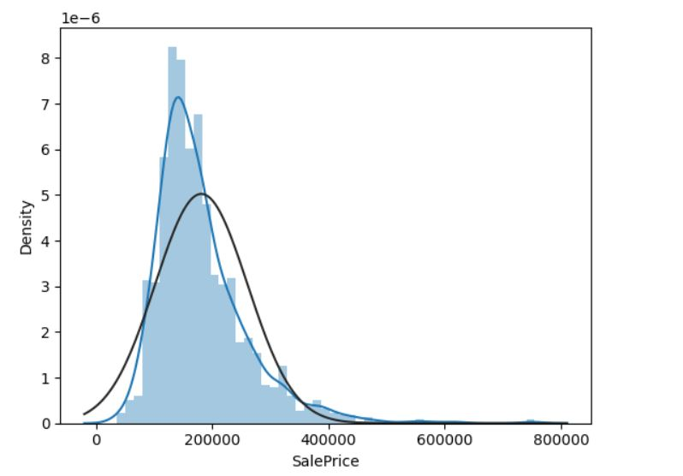
Sale Price Curve
The distribution of the target (sale price) is not normal

Slide 11
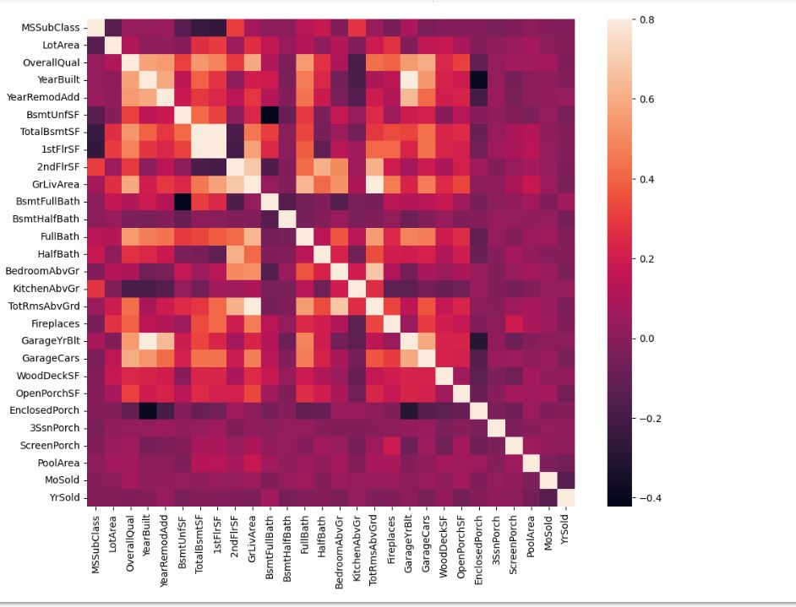
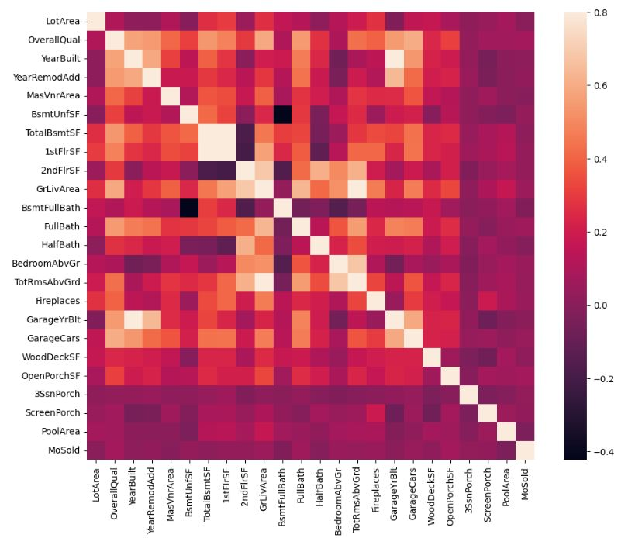
Correlation Matrix Before and After Dropping of Selected Columns

Slide 12
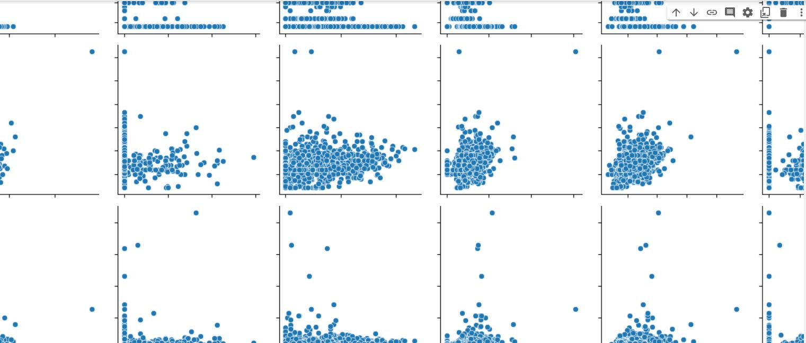
Seaborn pair-to-pair relationships for all quantitative features

Slide 13

Data Preprocessing
Replace missing data with zero or average value of the feature, depending on which column it is. Null values for “Fence” and “Central Air” were replaced with the category for “no.” For all other categorical features, null values were replaced with “unknown.” For numeric values, all null values were replaced with the mane of the column
Create a Pandas DataFrame to hold manually-selected quantitative fields using drop() and area of files to drop
Create a Pandas DataFrame to hold all manually-selected qualitative fields, as with quantitative fields
Use Pandas get_dummies() function to encode selected qualitative fields, and drop original fields when complete
Concatenate the two DataFrames
Scale all data

Slide 14
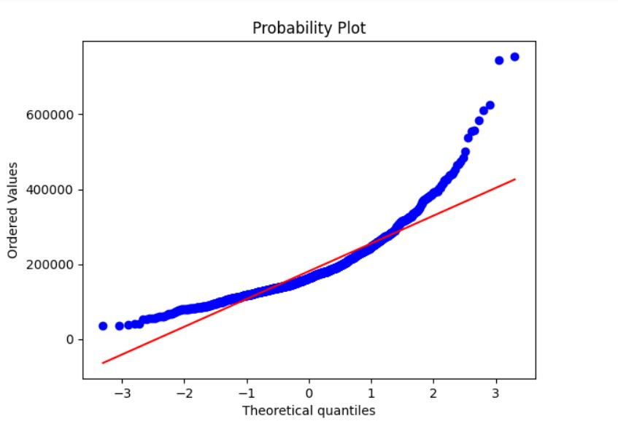
Linear Regression Model
Y is sale price, X is all remaining features (37 raw, 150 embedded)
Create the model
Train the model
Evaluate means mean squared error and r squared
Use Seaborn for plotting

Slide 15
Optimization
Other models were evaluated for comparison to the linear regression model.
Ridge Regression
Lasso Regression
Random Forests
Deep Neural Networks
All of these require far more configuration than for linear regression. A keras tuner was used to configure the neural network model and the others were slightly hand tuned, with about 5 runs each. A tuning script would be very beneficial to configure the hyperparameters,

Slide 16
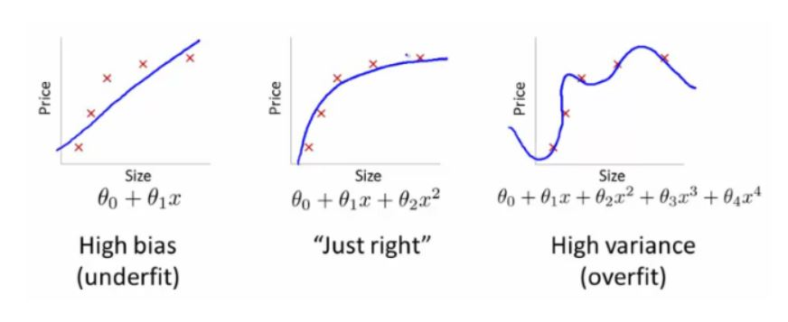
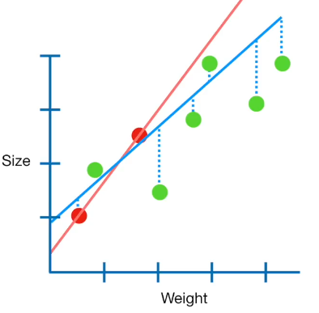
Optimization
Ridge Regression
Method of attempting to reduce complexity in a dataset with many features, many of which may have small number of outlier values.
Rather than dropping a column altogether, adds a penalty field
This reduces the magnitude of each coefficient, so it approaches zero, but is not entirely eliminated
Reduces MSE and attempts stop find optimal balance between bias and accuracy.
The penalty does lower the accuracy to some extent, in order to prevent overfitting, which is a common problem with this type of data, because the rare outlier values have large coefficients which end up making the model unable to predict accurately, because the rare values have too much weight in the analysis

Slide 17
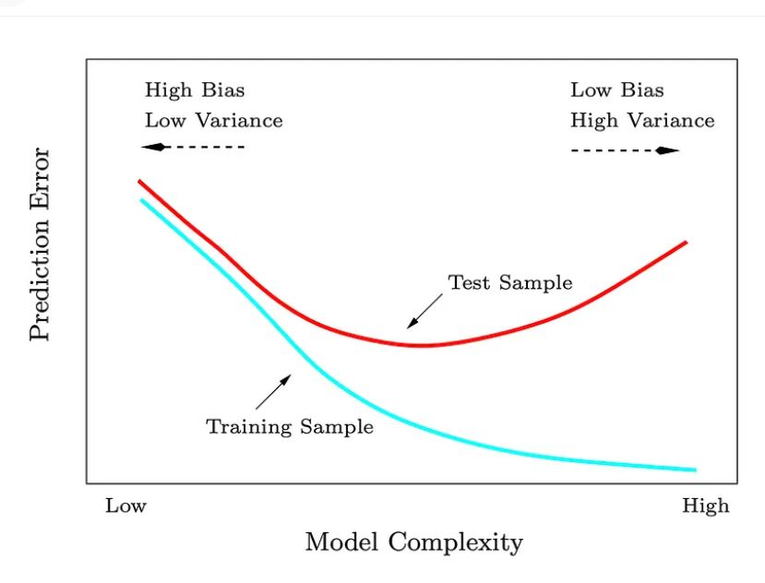
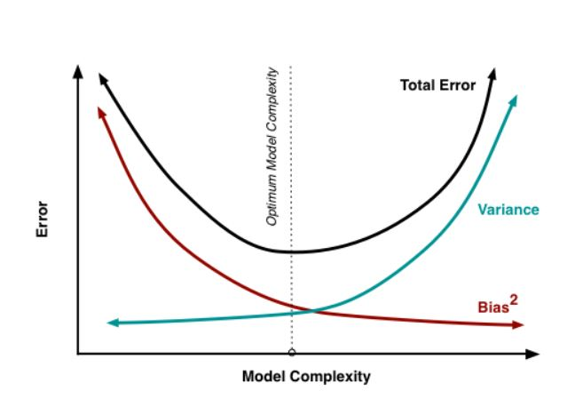
Ridge Regression

Slide 18
Results
Linear Regression r-squared: 0.8530
Ridge Regression r-squared: 0,8504
Lasso Regression r-squared: 0.8573
Random Forests accuracy: abysmal, not useful
Neural Network accuracy: abysmal, not useful

Slide 19
Future Work
Tensor flow
No preprocessing
Handles qualitative, quantitative, and missing values
Inherent mapping functions

